Slide 1


USMAN GHANI
11-05-2025

Slide 2

Outline
Executive Summary
Introduction
Methodology
Results
Conclusion
Appendix

Slide 3
Executive Summary
Summary of methodologies:
1. Data collection through api.
2. Data collection with web scrapping.
3. Data wrangling.
4. Exploratory Data Analysis with SQl.
5. Exploratory Data Analysis with Data Visualization.
6. Interactive Visual Analytics with Folium.
7. Interactive Dashboard with Plotly Dash.
Summary of all results:
1.Exploratory Data Analysis result
2.Interactive analytics in screenshots
3.Predictive Analytics result

Slide 4
Introduction
Project background and context:
Space X advertises Falcon 9 rocket launches on its website with a cost of 62 million dollars; other providers cost upward of 165 million dollars each, much of the savings is because Space X can reuse the first stage. Therefore, if we can determine if the first stage will land, we can determine the cost of a launch. This information can be used if an alternate company wants to bid against space X for a rocket launch. This goal of the project is to create a machine learning pipeline to predict if the first stage will land successfully.
Problems you want to find answers
What factors determine if the rocket will land successfully?
The interaction amongst various features that determine the success rate of a successful landing.
What operating conditions needs to be in place to ensure a successful landing program.

Slide 5

Section 1

Slide 6
Methodology
Executive Summary
Data collection methodology:
Data was collected using SpaceX API and web scraping from Wikipedia.
Perform data wrangling
One-hot encoding was applied to categorical features
Perform exploratory data analysis (EDA) using visualization and SQL
Perform interactive visual analytics using Folium and Plotly Dash
Perform predictive analysis using classification models
How to build, tune, evaluate classification models

Slide 7
Data Collection
The data was collected using various methods
Data collection was done using get request to the SpaceX API.
Next, we decoded the response content as a Json using .json() function call and turn it into a pandas dataframe using .json_normalize().
We then cleaned the data, checked for missing values and fill in missing values where necessary.
In addition, we performed web scraping from Wikipedia for Falcon 9 launch records with BeautifulSoup.
The objective was to extract the launch records as HTML table, parse the table and convert it to a pandas dataframe for future analysis.

Slide 8
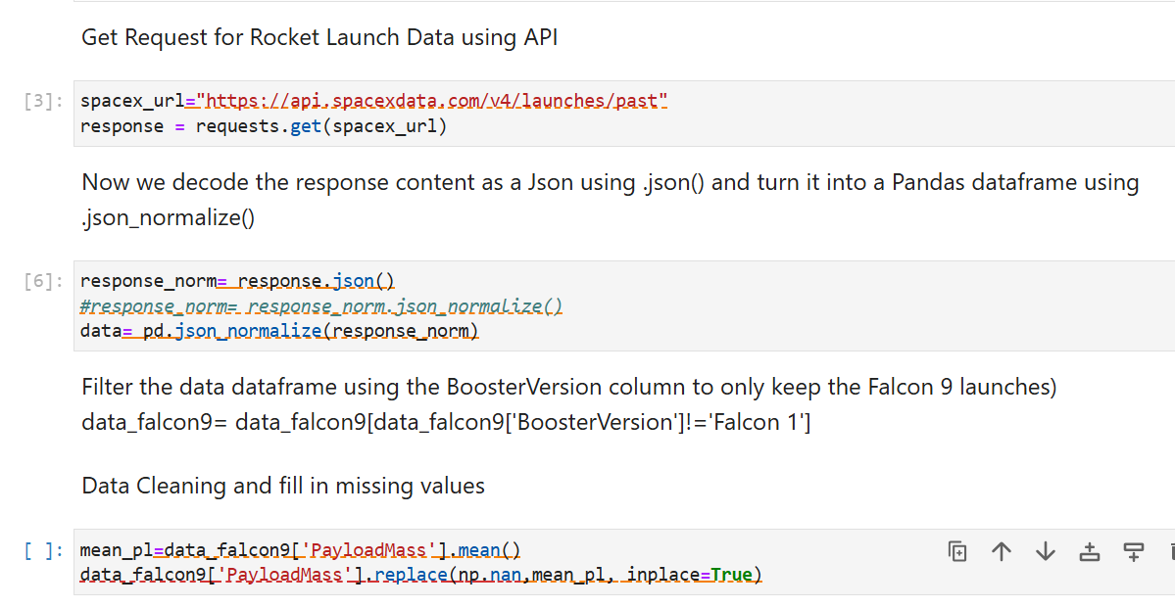
Data Collection – SpaceX API
We used the get request to the SpaceX API to collect data, clean the requested data and did some basic data wrangling and formatting.
The link to the notebook is
https://github.com/G-o-ah/IBM-SpaceX-Capestone/blob/main/Data%20Collection%20API.ipynb

Slide 9
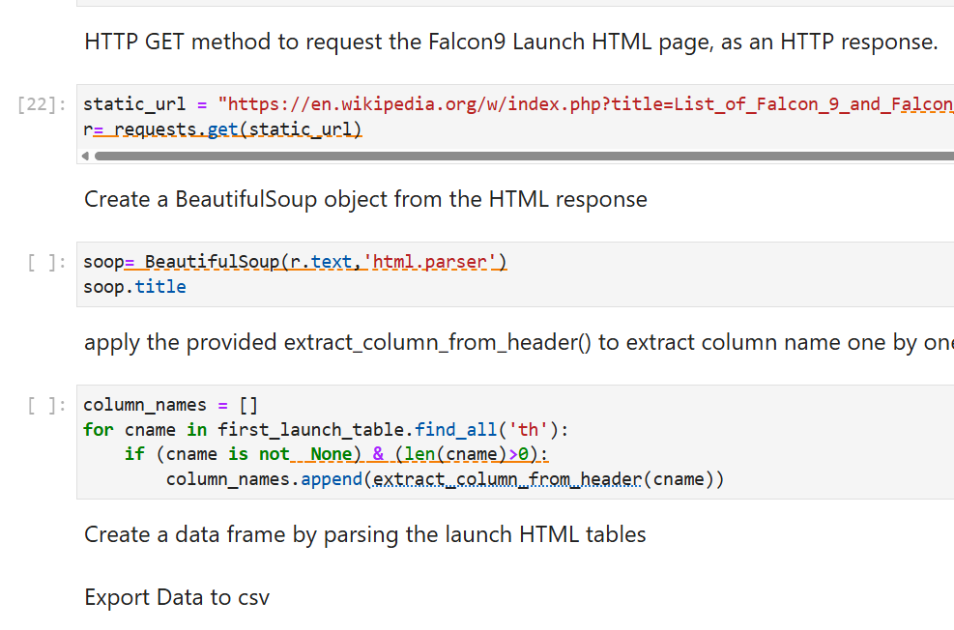
Data Collection - Scraping
We applied web scrapping to webscrap Falcon 9 launch records with BeautifulSoup
We parsed the table and converted it into a pandas dataframe.
https://github.com/G-o-ah/IBM-SpaceX-Capestone/blob/main/Data%20Collection%20Web%20Scrapping.ipynb

Slide 10

Data Wrangling
We performed exploratory data analysis and determined the training labels.
We calculated the number of launches at each site, and the number and occurrence of each orbits
We created landing outcome label from outcome column and exported the results to csv.
The link to the notebook is
https://github.com/G-o-ah/IBM-SpaceX-Capestone/blob/main/Data%20Wrangling.ipynb

Slide 11
EDA with Data Visualization
We explored the data by visualizing the relationship between flight number and launch Site, payload and launch site, success rate of each orbit type, flight number and orbit. A bar diagram makes it easy to compare sets of data between different groups at a glance.
The graph represents categories on one axis and a discrete value in the other. The goal is to show the relationship between the two axes. Bar charts can also show big changes in data over time.
Line graphs are useful in that they show data variables and trends very clearly and can help to make predictions about the results of data not yet recorded.
LINK: http://github.com/G-o-ah/IBM-SpaceX-Capestone/blob/main/EDA%20with%20Data%20Visualization.ipynb

Slide 12
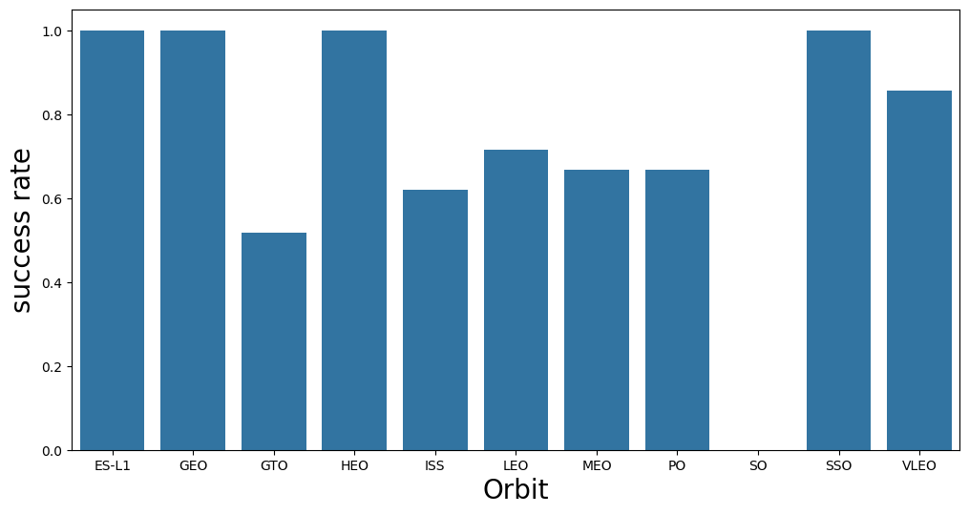
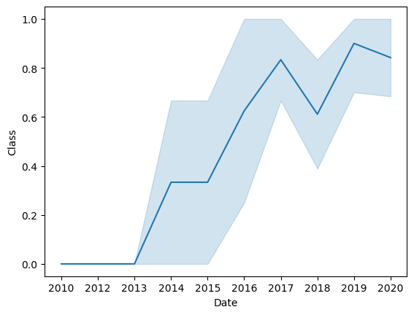
EDA with Data Visualization
Visualize the relationship between success rate of each orbit type
Visualize the launch success yearly trend

Slide 13
EDA with SQL
Display the names of the unique launch sites in the space mission.
Display 5 records where launch sites begin with the string 'CCA'.
Display the total payload mass carried by boosters launched by NASA (CRS).
Display average payload mass carried by booster version F9 v1.1
List the date when the first succesful landing outcome in ground pad was acheive.
List the names of the boosters which have success in drone ship and have payload mass greater than 4000 but less than 6000.
List the total number of successful and failure mission outcomes.
List all the booster_versions that have carried the maximum payload mass. Use a subquery.
List the records which will display the month names, failure landing_outcomes in drone ship ,booster versions, launch_site for the months in year 2015.
Rank the count of landing outcomes (such as Failure (drone ship) or Success (ground pad)) between the date 2010-06-04 and 2017-03-20, in descending order.
LINK: https://github.com/G-o-ah/IBM-SpaceX-Capestone/blob/main/EDA%20With%20SQL.ipynb

Slide 14
Build an Interactive Map with Folium
We marked all launch sites, and added map objects such as markers, circles, lines to mark the success or failure of launches for each site on the folium map.
We assigned the feature launch outcomes (failure or success) to class 0 and 1.i.e., 0 for failure, and 1 for success.
Using the color-labeled marker clusters, we identified which launch sites have relatively high success rate.
LINK: https://github.com/G-o-ah/IBM-SpaceX-Capestone/blob/main/Interactive_Visual_Analytics_Folium.ipynb
We calculated the distances between a launch site to its proximities. We answered some question for instance:
Are launch sites near railways, highways and coastlines.
Do launch sites keep certain distance away from cities.

Slide 15
Build a Dashboard with Plotly Dash
We built an interactive dashboard with Plotly dash
We plotted pie charts showing the total launches by a certain sites
We plotted scatter graph showing the relationship with Outcome and Payload Mass (Kg) for the different booster version.
link: https://github.com/G-o-ah/IBM-SpaceX-Capestone/blob/main/IBM_Dash.py

Slide 16
Predictive Analysis (Classification)
We loaded the data using numpy and pandas, transformed the data, split our data into training and testing.
We built different machine learning models using different methods and tune different hyperparameters using GridSearchCV.
We used accuracy as the metric for our model, improved the model using feature engineering and algorithm tuning.
We found the best performing classification model.
LINK: https://github.com/G-o-ah/IBM-SpaceX-Capestone/blob/main/Machine%20Learning%20Prediction.ipynb

Slide 17
Results
Exploratory data analysis results
Interactive analytics demo in screenshots
Predictive analysis results

Slide 18

Section 2

Slide 19
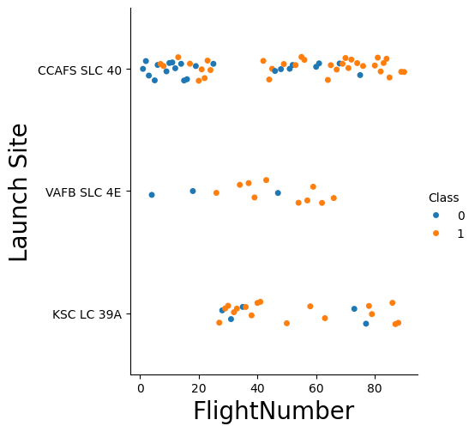
Flight Number vs. Launch Site
CCAFS SLC-40 (top row) and KSC LC-39A (bottom row) have many high‐flight-number missions, and most of those later flights are successful (more orange dots as x increases)
VAFB SLC-4E (middle row) has fewer total missions, and successes (orange) start appearing at mid-range flight numbers.
Overall, success rate improves with higher flight numbers (more orange than blue on the right side), reflecting growing operational maturity.

Slide 20
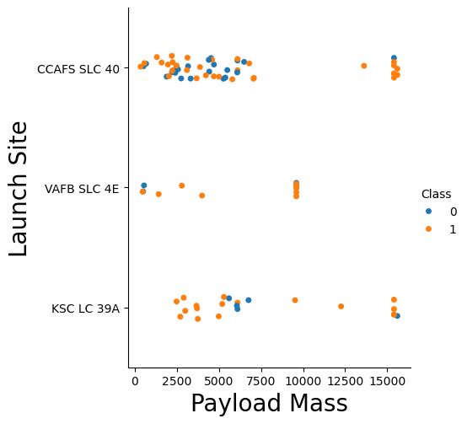
Payload vs. Launch Site
CCAFS SLC-40 (top row) launches payloads between ~2 000 kg and ~8 000 kg, with a mix early on but nearly all successes at higher masses.
VAFB SLC-4E (middle) has fewer launches, clustered under ~3 000 kg and around ~10 000 kg, with success improving over time.
KSC LC-39A (bottom) handles the widest range (up to ~15 000 kg), and almost every high-mass mission from this site succeeded.
Overall, heavier payloads and later flights show higher success rates across all sites.

Slide 21
Success Rate vs. Orbit Type
100% success for deep-space and high-inclination orbits:
ES-L1, GEO, HEO, and SSO missions never failed in your dataset.
Very high success for very low Earth orbit (VLEO).
Moderate success for LEO , MEO , and PO.
Lower success for ISS-resupply.
Lowest success for GTO missions.
SO shows 0% because there were no successful missions (likely only failures or no data).
In short, the hardest orbits (GTO, ISS) see the most failures, while unique deep-space (ES-L1, GEO, HEO) and Sun-synchronous (SSO) missions have perfect records.

Slide 22
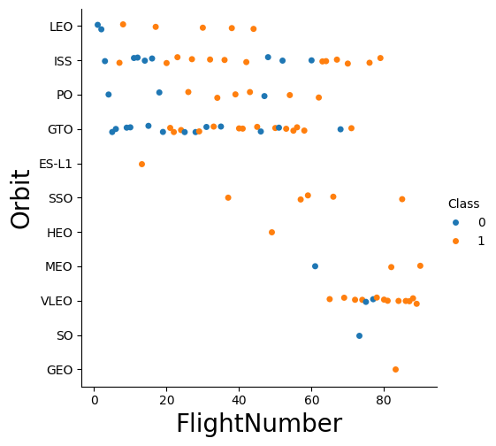
Flight Number vs. Orbit Type
Early Flights across all orbits have more failures (blue), but success rates climb as flight number increases.
LEO and ISS missions (top rows) see a transition from mixed outcomes at low flight numbers to mostly successes beyond ~30.
GTO (mid row) also improves—early GTO flights had failures, but later flights become reliably successful.
High-mass orbits like VLEO and MEO (lower rows) start later (higher flight numbers) and are predominantly successful.
Rare orbits (SO, GEO, ES-L1) cluster at specific flight numbers with a few failures early on, then full success.
In short, operational maturity shows up clearly: as SpaceX gains experience (higher flight numbers), success becomes the norm across every orbit.

Slide 23
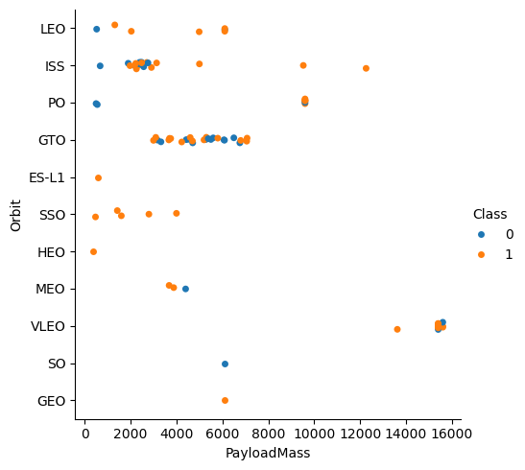
Payload vs. Orbit Type
LEO/ISS (top rows) cluster at lower masses (<4 000 kg). Early missions show mixed outcomes, but beyond ~2 000 kg almost all are successful.
GTO missions (mid-row) dominate the 3 000–8 000 kg range. Failures occur early in that band, then orange successes take over.
High-mass orbits like VLEO (lower row) appear at >12 000 kg and are almost entirely successful.
Specialty orbits (ES-L1, SSO, HEO, GEO, SO) have only a handful of points—mostly orange—indicating strong success rates once those services ramped up.
Bottom line: as payload mass and operational experience grow, SpaceX’s success rate climbs across every orbit type.

Slide 24
Launch Success Yearly Trend
2010–2013: 0% success (no wins until 2013).
2014–2015: Climb into the 30–35% range.
2016: Jumps above 60%.
2017: Peaks near 85%.
2018: Dips to ~60%.
2019–2020: Rises again to around 90% in 2019 and stays in the mid-80% range by 2020.
Bottom line: SpaceX’s year-on-year launch success rate has steadily improved, stabilizing above 80% in recent years.

Slide 25
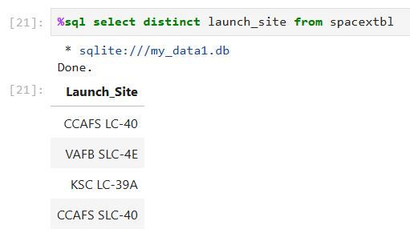
All Launch Site Names
We used distinct Keyword so that we can only show unique launch sites. %sql is a line magic so that we execute that line as a sql.

Slide 26
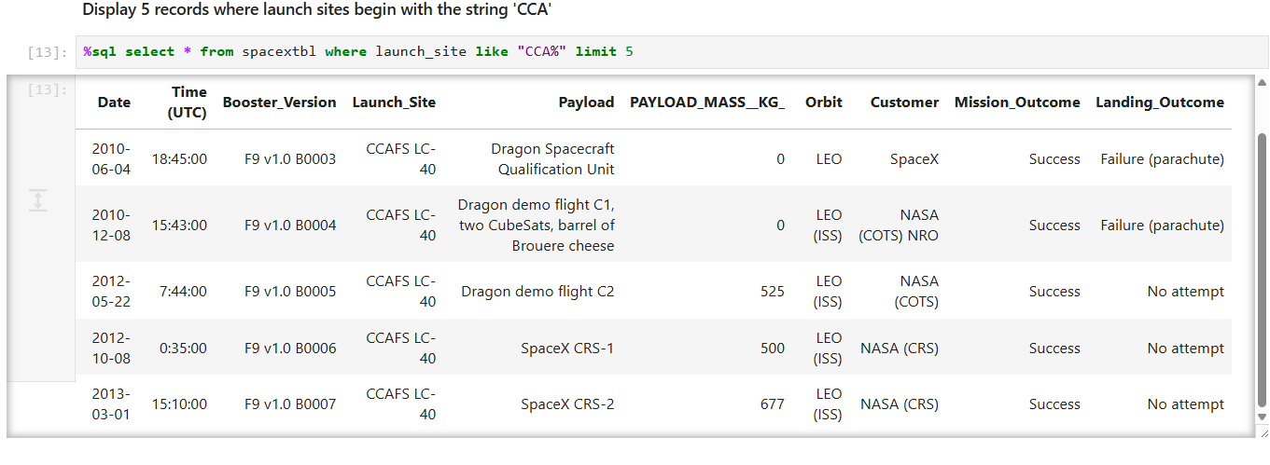
Launch Site Names Begin with 'CCA'
We used the query above to display 5 records where launch sites begin with `CCA

Slide 27
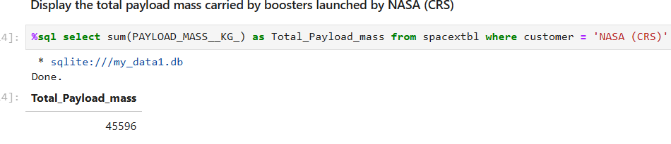
Total Payload Mass
We calculated the total payload carried by boosters from NASA as 45596 using the query below

Slide 28
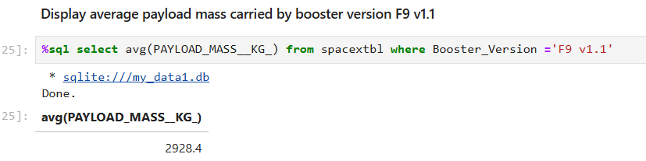
Average Payload Mass by F9 v1.1
We calculated the average payload mass carried by booster version F9 v1.1 as 2928.4

Slide 29
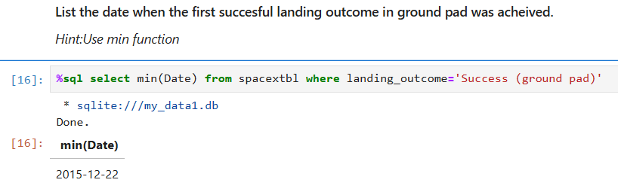
First Successful Ground Landing Date
We observed that the dates of the first successful landing outcome on ground pad was 22nd December 2015

Slide 30
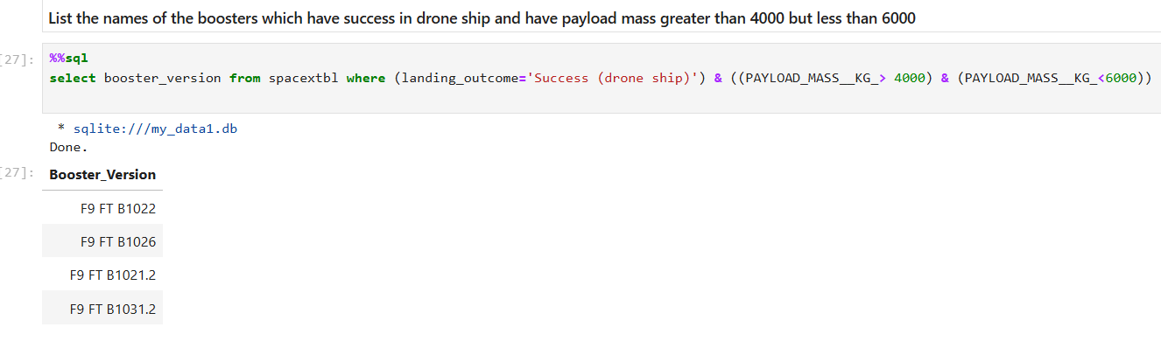
Successful Drone Ship Landing with Payload between 4000 and 6000
We used the WHERE clause to filter for boosters which have successfully landed on drone ship and applied the AND condition to determine successful landing with payload mass greater than 4000 but less than 6000

Slide 31
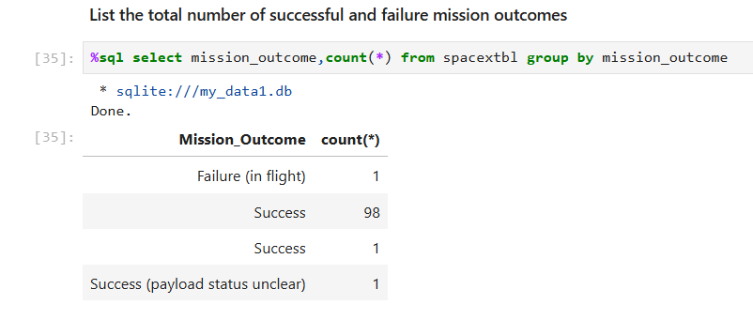
Total Number of Successful and Failure Mission Outcomes
Total number of successful mission outcome = 100
Total number of failed mission outcome = 1

Slide 32
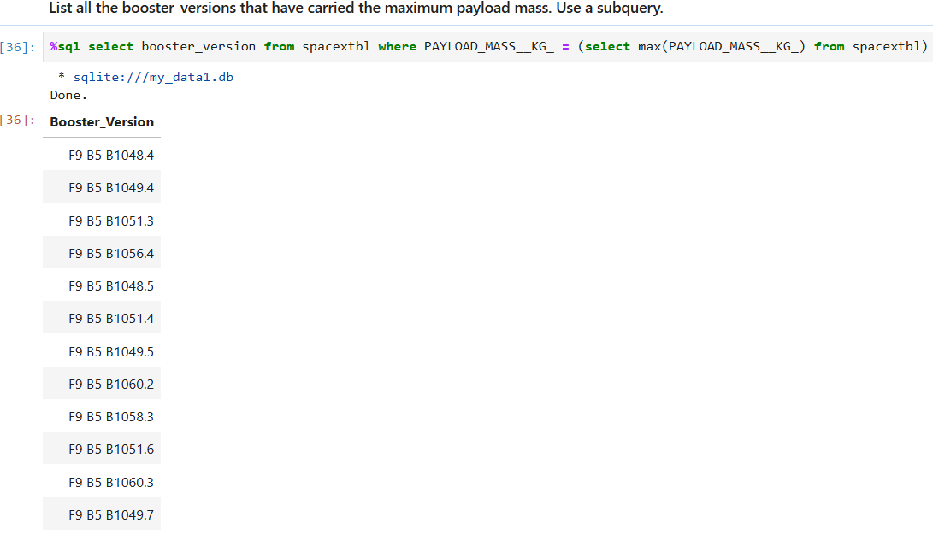
Boosters Carried Maximum Payload
We determined the booster that have carried the maximum payload using a subquery in the WHERE clause and the MAX() function.

Slide 33
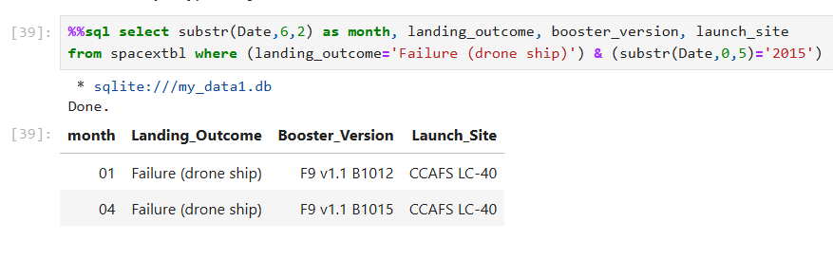
2015 Launch Records
Note: SQLLite does not support monthnames. So you need to use substr(Date, 6,2) as month to get the months and substr(Date,0,5)='2015' for year. so we used substr.
%%sql is a cell magic which treat the entire cell as a sql.

Slide 34
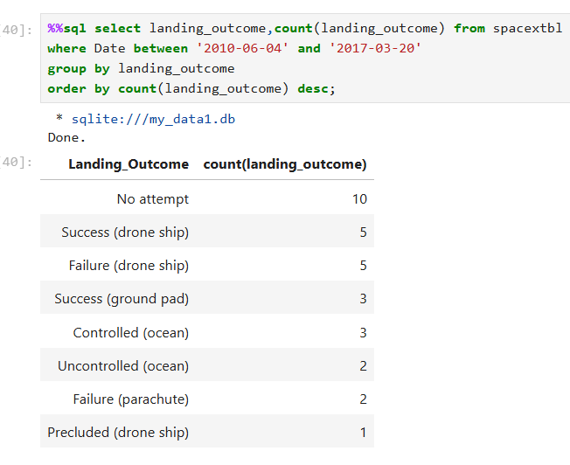
Rank Landing Outcomes Between 2010-06-04 and 2017-03-20

Slide 35

Section 3

Slide 36
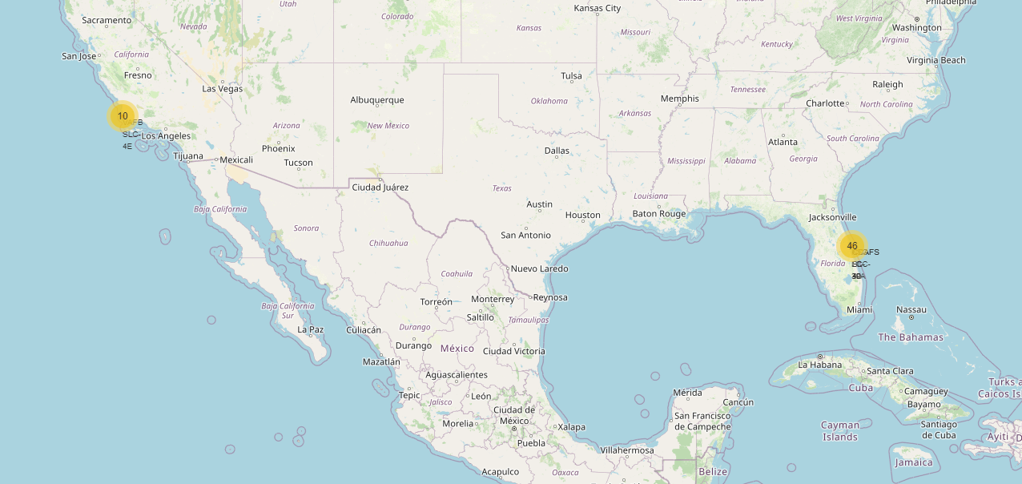
LAUNCH SITES

Slide 37
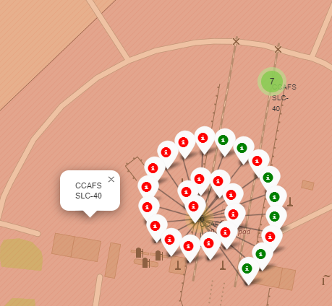
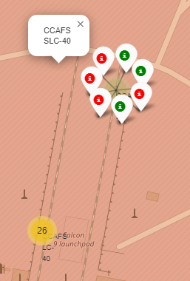
LAUNCH OUTCOMES

Slide 38
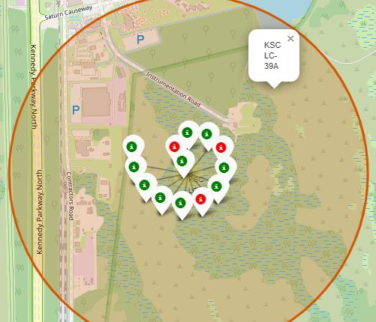
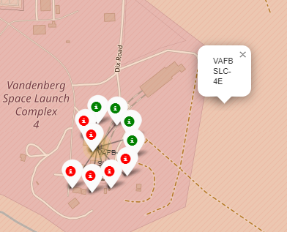
CONTINUED

Slide 39
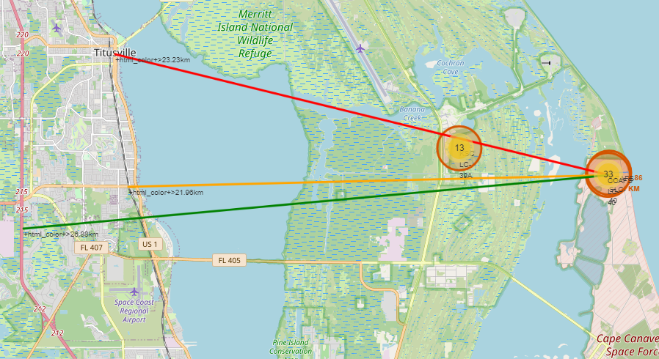
Distances to Proximities

Slide 40

Section 4

Slide 41
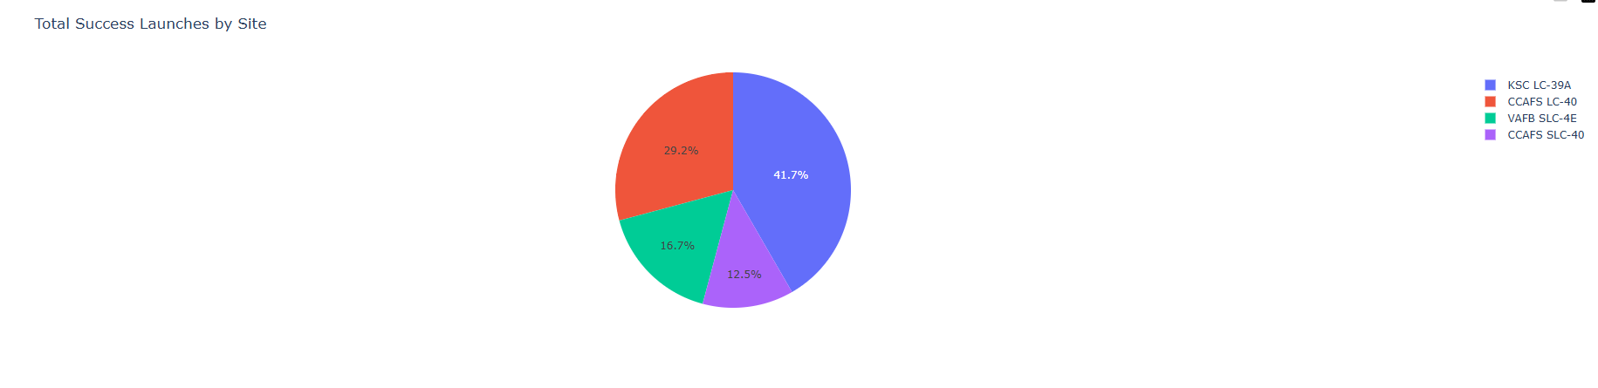
Show the screenshot of launch success count for all sites, in a piechart
KSC LC-39A has the most successful launches amongst launch sites .(41.2%)

Slide 42
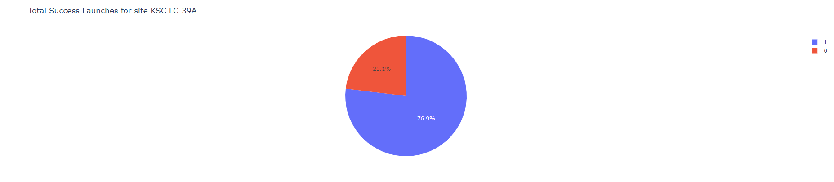
piechart for the launch site with highest launch success ratio
KSC LC-39A has the highest success rate amongst launch sites (76.9%)
10 successful launches and 3 failed launches.

Slide 43
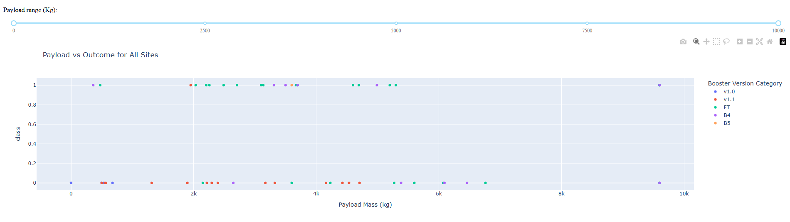
Show screenshots of Payload vs. Launch Outcome scatter plot for all sites, with different payload selected in the range slider

Slide 44

Section 5

Slide 45
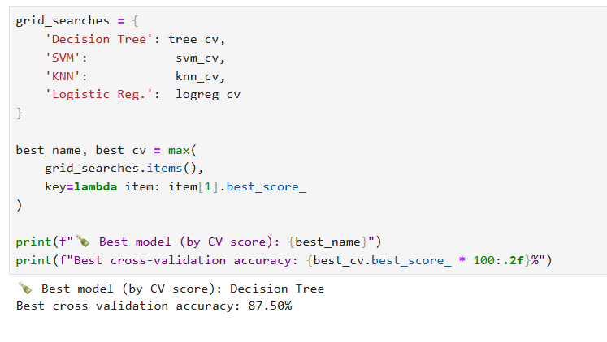
Classification Accuracy

Slide 46
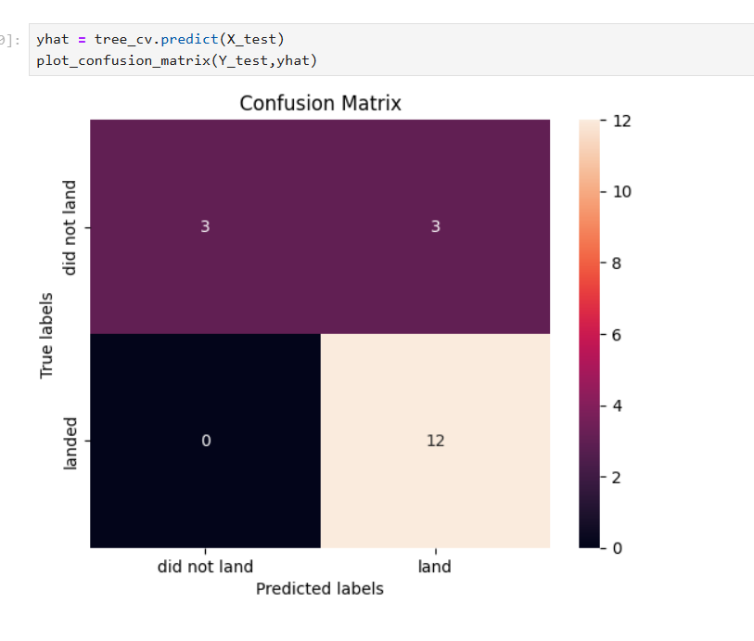
Confusion Matrix

Slide 47
Conclusions
The larger the flight amount at a launch site, the greater the success rate at a launch site.
All the launch sites are close to the coast
Launch Success: Increases over time
Launch success rate started to increase in 2013 till 2020.
Orbits ES-L1, GEO, HEO, SSO, VLEO had the most success rate.
KSC LC-39A had the most successful launches of any sites.
The Decision tree classifier is the best machine learning algorithm for this task.

Slide 48
APpendix
https://github.com/G-o-ah/IBM-SpaceX-Capestone

Slide 49


